Slide 1

Subject Name: OOP
Unit No:1
Unit Name: Introduction to OOP

Slide 2
Index
Lecture 1 – Basic Concepts of Object-Oriented Programming | 7
Lecture 2 – Need of OOP, Object Oriented Programming Paradigm | 21
Lecture 3 – Benefits of OOP, Introduction to OOP languages : C++ and Java | 34

Slide 3
Course Schema
Teaching Scheme &Evaluation Scheme:
Course Code | Course Name | Teaching Scheme (Contact Hours) |  |  |  |  |  |  | Credits Assigned
 |  | Theory |  | Practical |  |  | Tutorial |  | Theory |  | Tutorial | PR / ORAL | Total
231CEUCC32 | Object Oriented Programming | 03 |  | -- |  |  | -- |  | 03 |  | -- | -- | 03
Course Code | Course Name | Examination Scheme
 |  | Theory |  |  |  |  |  |  |  |  | TW | PR | Total
 |  | Internal Assessment |  |  |  |  |  | End Sem Exam |  | Exam. Duration (in Hrs)
 |  | Test1 | Test2 |  | Avg. | Mid Sem Exam
231CEUCC32 | Object Oriented Programming | 20 | 20 |  | 20 | 20 |  | 60 |  | 02 | -- | -- | 100

Slide 4
Course Schema
Teaching Scheme &Evaluation Scheme:
Course Code | Course Name | Teaching Scheme (Contact Hours) |  |  |  |  |  |  | Credits Assigned
 |  | Theory |  | Practical |  |  | Tutorial |  | Theory |  | Tutorial | PR / ORAL | Total
231CEUCL32 | Object Oriented Programming Lab | -- |  | 02 |  |  | -- |  | -- |  | -- | 01 | 01
Course Code | Course Name | Examination Scheme
 |  | Theory |  |  |  |  |  |  |  |  | TW | PR | Total
 |  | Internal Assessment |  |  |  |  |  | End Sem Exam |  | Exam. Duration (in Hrs)
 |  | Test1 | Test2 |  | Avg. | Mid Sem Exam
231CEUCL32 | Object Oriented Programming Lab | -- | -- |  | -- | -- |  | -- |  | -- | 25 | 25 | 50

Slide 5
Course Objectives
1. To understand the object-oriented programming basics and its features.
2. Able to use a programming language to resolve problems.
3. To understand and apply Object Oriented Programming (OOP) principles using Java.
4. To study various java programming concept like multithreading, exception handling, packages etc.
5. To explain components of GUI based programming.

Slide 6
Course Outcomes
Students will be able to :
1. Understand basics of OOP and apply fundamental programming constructs.
2. Understand and illustrate the features of classes and objects.
3. Elaborate the concept of strings, arrays and vectors.
4. Develop a program that implements the concept of inheritance, interfaces and packages.
5. Implement the notion of exception handling and multithreading.
6. Develop GUI based application.

Slide 7
Module No 1: Introduction to OOP
Lecture No: 1
Basic Concepts of Object-Oriented Programming

Slide 8
Introduction to Programming
Program:
  Program (also software or application) is a sequence of instructions written to perform a specified task with a computer.
Programmer:
  A person who practices this skill of writing program is referred to as a computer programmer or software developer or coder.
Programming:
  Programming is the iterative process of writing or editing source code. Editing source code involves testing, analyzing, refining and sometimes coordinating with other programmers on a jointly developed program.
Lecture No:1 Basic Concepts of Object-Oriented Programming

Slide 9
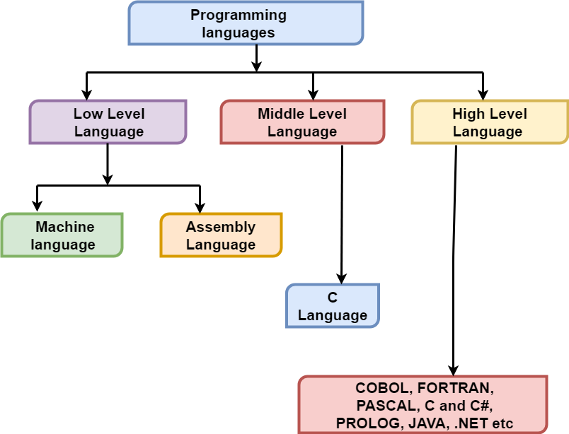
Hierarchy of Programming Languages
Lecture No:1 Basic Concepts of Object-Oriented Programming

Slide 10
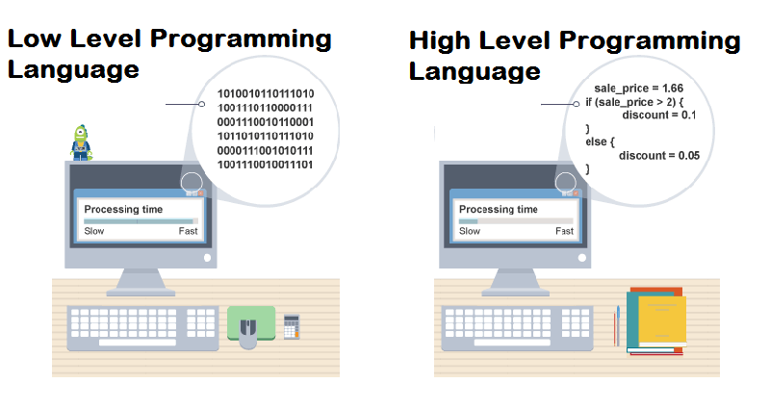
Why to Learn High Level Languages
Lecture No:1 Basic Concepts of Object-Oriented Programming

Slide 11
Programming Approaches
Procedure-Oriented: Top-Down Approach
Object-Oriented: Bottom-Up Approach
Programming Approaches
Procedure-Oriented/ Structured
Object-Oriented
Figure: Programming Approaches
Lecture No:1 Basic Concepts of Object-Oriented Programming

Slide 12
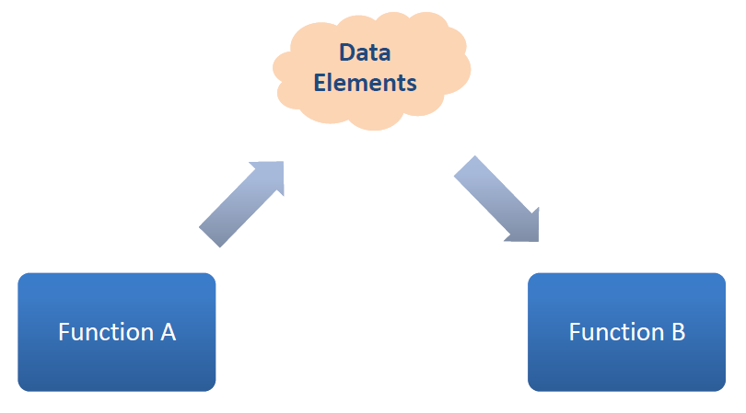
Procedural Programming
  Traditional programming languages were procedural.
    E.g. C, Pascal, BASIC, Ada and COBOL
  Programming in procedural languages involves choosing data structures (appropriate ways to store data), designing algorithms, and translating algorithm into code.
  In procedural programming, data and operations on the data are separated.
  This methodology requires sending data to procedure/functions.
Figure: Procedural Programming
Lecture No:1 Basic Concepts of Object-Oriented Programming

Slide 13
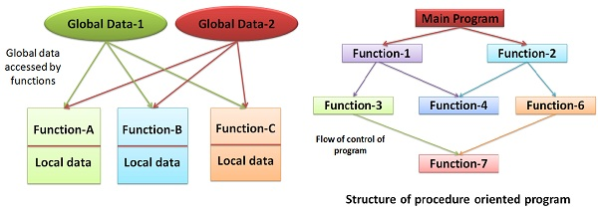
Structure of Procedure-oriented Programming
Lecture No:1 Basic Concepts of Object-Oriented Programming

Slide 14
Structured Programming Approach
The program is made as a single structure i.e. the code will execute the instruction by instruction one after the other.
It doesn’t support the possibility of jumping from one instruction to some other with the help of any statement like GOTO, etc. Therefore, the instructions in this approach will be executed in a serial and structured manner.
C is called a structured programming language because to solve a large problem, C programming language divides the problem into smaller structural blocks each of which handles a particular responsibility.
These structural blocks are –
Decision making blocks like if-else-elseif, switch-cases,
Repetitive blocks like For-loop, While-loop, Do-while loop etc
Subroutines/Procedures - functions
Lecture No:1 Basic Concepts of Object-Oriented Programming

Slide 15
Advantages of Structured Programming
C structured programming is simple and easy to understand and implement.
It is well sited for small size implementation. However this is not restricted. A good design can extend it to large size implementation.
Programmers do not require to know complex design concepts to start a new program.
Easier to Debug
These are mainly problem oriented rather than machine based.
Program written in a higher level language can be translated into many machine languages and therefore can run on any computer for which there exists an appropriate translator.
It is independent of machine on which it is used i.e. programs developed in high level languages can be run on any computer.
Lecture No:1 Basic Concepts of Object-Oriented Programming

Slide 16
Disadvantages of Structured Programming
A high level language has to be translated into the machine language by translator and thus a price in computer time is paid.
Since it is Machine-Independent, So it takes time to convert into machine code.
The code generated by a translator might be inefficient compared to an equivalent assembly language program.
Data type are proceeds in many functions in a structured program. When changes occur in those data types, the corresponding change must be made to every location that acts on those data types within the program. This is really a very time consuming task if the program is very large.
Data and methods are not bind together in a module.
Lecture No:1 Basic Concepts of Object-Oriented Programming

Slide 17
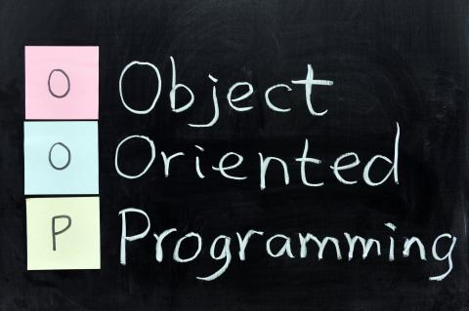
Object Oriented Approach
Object oriented approach organizes a program in the form of objects
Focus on data
Program is organized around data
Data and operations are grouped together
  Objects = Data+ Methods
Lecture No:1 Basic Concepts of Object-Oriented Programming

Slide 18
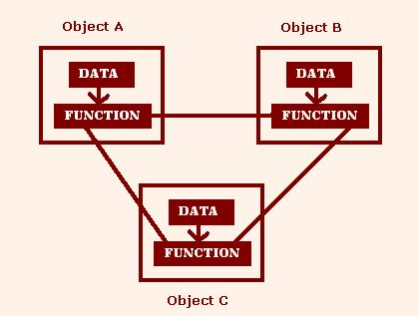
Object-Oriented Programming
Object-oriented programming is centered on creating objects rather than procedures/ functions.
Objects are a melding of data and procedures that manipulate that data.
Figure: Object-Oriented Programming
Lecture No:1 Basic Concepts of Object-Oriented Programming

Slide 19
Procedural vs Object oriented programming
Procedural
Withdraw, deposit, transfer
Object Oriented
Customer, money, account
Lecture No:1 Basic Concepts of Object-Oriented Programming

Slide 20
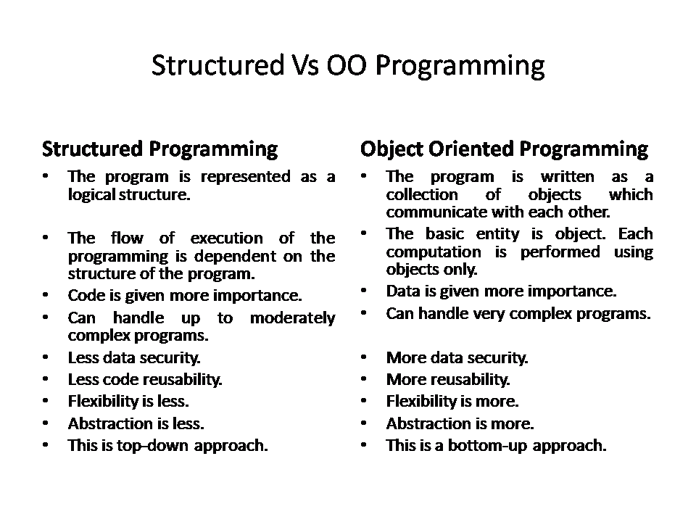
Difference between Structured and Object Oriented Approach
E.g: C, VB, FORTRAN, Pascal | E.g: C++, JAVA, VB.NET, C#.NET
Lecture No:1 Basic Concepts of Object-Oriented Programming

Slide 21
Module No 1: Introduction to OOP
Lecture No: 2
Need of OOP, Object Oriented Programming Paradigm

Slide 22
Need of OOP
Language close to hardware
Easy to understanding
Millions of software developers use C++,Java
C++, Java is the most widely used programming languages
Hardware
Object Oriented Programming
Software Developers Choice
Application And System Programming.
C++, Java really teaches you the difference between compiler, linker and loader, different data types, storage classes,
Difference Between Compiler, Linker And Loader
Lecture No:2 Need of OOP, Object Oriented Programming Paradigm

Slide 23
Applications of OOP
Application Software Development
Operating System: Windows, Mac OSX and Linux.
Programming Languages Development
C#, Java, JavaScript, Perl, UNIX’s C Shell, PHP and Python, and Verilog etc.
Computation Programming
Has a fast speed and computational efficiencies.
Games Development
Embedded System
Medical and Engineering Applications like softwares for MRI machines, high-end CAD/CAM systems etc.
Browsers : Mozilla Firefox and Chrome
database system: MySQL.
Procedural programming for CPU intensive functions and provides greater control over hardware
Lecture No:2 Need of OOP, Object Oriented Programming Paradigm

Slide 24
Features of OOP
Striking features of OOP
Emphasis data
Program divided into object
Data structure
Function
Hidden Data
Object Communication
New data/function easily add
Follow bottom of approach
Lecture No:2 Need of OOP, Object Oriented Programming Paradigm

Slide 25
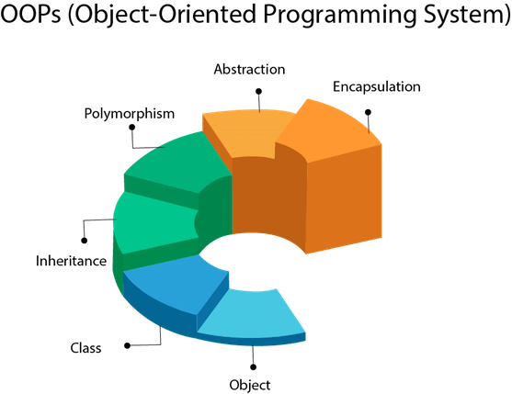
Object Oriented Paradigm
Lecture No:2 Need of OOP, Object Oriented Programming Paradigm

Slide 26
Object Oriented Programming
Classes
Objects
Abstraction
Encapsulation
Inheritance
Polymorphism
Dynamic Binding
Message Passing
Lecture No:2 Need of OOP, Object Oriented Programming Paradigm

Slide 27
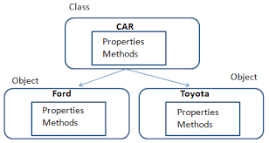
Classes and Objects
Classes
Basic building blocks OOP and a single entity which has data and operations on data together.
Classes are user-defined data types and behave like the built-in types of a programming language.
Objects
Objects are the basic run-time entities.
The instances of a class which are used in real functionality(properties and methods)
When a program is executed the objects interact by sending messages to one another.
Lecture No:2 Need of OOP, Object Oriented Programming Paradigm

Slide 28

Abstraction
Abstraction refers to the act of representing essential features without including the background details or explanations.
Specifying what to do but not how to do.
It is a flexible feature for having a overall view of an object’s functionality.
Classes use the concept of abstraction and are defined as a list of abstract attributes such as size, weight and cost, and functions to operate on these functions.
Since the classes use the concept of data abstraction, they are known as Abstract Data Types.
Lecture No:2 Need of OOP, Object Oriented Programming Paradigm

Slide 29
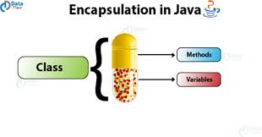
Encapsulation
The wrapping up of data and functions into a single unit is known as Encapsulation.
The data is not accessible to the outside world and only those functions which are wrapped in the class can access it.
This insulation of the data from direct access by the program is called data hiding or information hiding.
Lecture No:2 Need of OOP, Object Oriented Programming Paradigm

Slide 30
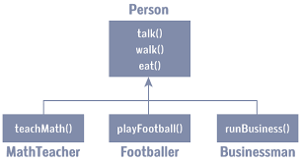

Inheritance
Inheritance is the process by which objects of one class acquire the properties of objects of another class.
The principle behind this sort of division is that each derived class shares common characteristics with the class from which it is derived.
In OOP the concept of inheritance provides the idea of reusability.
This means that we can add additional features to an existing class without modifying it.
Lecture No:2 Need of OOP, Object Oriented Programming Paradigm

Slide 31
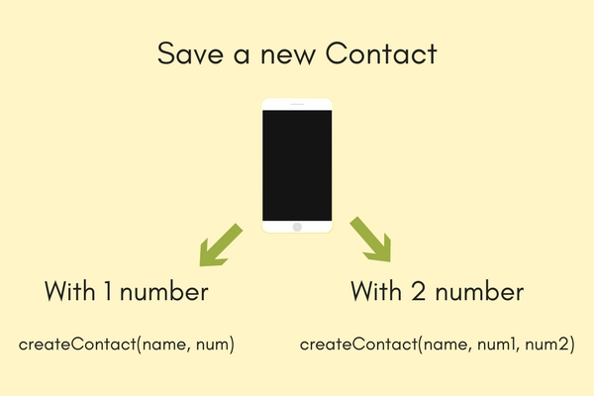
Polymorphism
Polymorphism means the ability to take more than one form.
Multiple definitions for a single name.
Functions with same name with different functionality
That is an operation may exhibit different behaviours in different instances.
saves time in investing many function names
The behaviour depends upon the types of data used in the operation.
Operator and Function overloading
Example: Operation of addition.
Lecture No:2 Need of OOP, Object Oriented Programming Paradigm

Slide 32
Dynamic Binding
Dynamic binding refers to the linking of a procedure call to a specific sequence of code.
The code to be executed for a specific procedure call is not known until run-time.
Dynamic dispatch is generally used when multiple classes contain different implementations of the same method.
It provides a mechanism for selecting the function to be executed from various function alternatives at the run-time.
It is associated with polymorphism and inheritance.
Lecture No:2 Need of OOP, Object Oriented Programming Paradigm

Slide 33
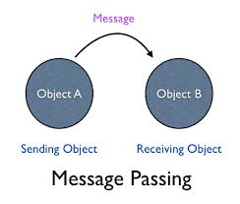
Message Communication
Object communicate with one another by sending and receiving information much the same way as people pass message to one another.
Objects communicates through invoking methods and sending data to them.
This feature of sending and receiving information among objects through function parameters is known as Message Passing.
Lecture No:2 Need of OOP, Object Oriented Programming Paradigm

Slide 34
Module No 1: Introduction to OOP
Lecture No: 3
Benefits of OOP, Introduction to OOP languages : C++ and Java

Slide 35
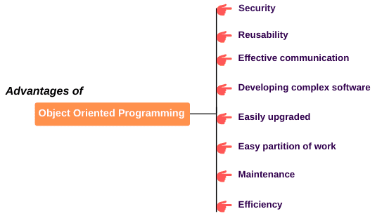
Benefits of OOP
Lecture No:3 Benefits of OOP, Introduction to OOP languages : C++ and Java

Slide 36
OOP: C++ Language
Developed by Bjarne Stroustrup in 1979.
an extension / superset of C language.
Supports both procedural and object oriented paradigm
The prime purpose of C++ programming was to add object orientation to the C programming language.
While designing C++ modules, we try to see whole world in the form of objects.
Classes
Objects
Data Abstraction
Data Encapsulation
Inheritance
Polymorphism
Lecture No:3 Benefits of OOP, Introduction to OOP languages : C++ and Java

Slide 37
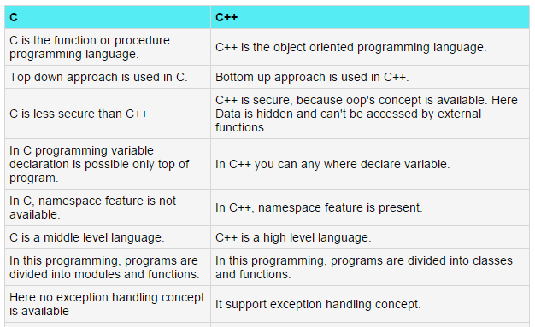
Difference Between C and C++
Lecture No:3 Benefits of OOP, Introduction to OOP languages : C++ and Java

Slide 38
OOP: Java Language
When we consider a Java program, it can be defined as a collection of objects that communicate via invoking each other's.
Object − Objects have states and behaviors. Example: A dog has states - color, name, breed as well as behaviors - wagging, barking, eating. An object is an instance of a class.
Class − A class can be defined as a template/blueprint that describes the behaviors/states that object of its type support.
Methods − A method is basically a behavior. A class can contain many methods. It is in methods where the logics are written, data is manipulated and all the actions are executed.
Instance Variables − Each object has its unique set of instance variables. An object's state is created by the values assigned to these instance variables.
Lecture No:3 Benefits of OOP, Introduction to OOP languages : C++ and Java

Slide 39
Difference Between C++ and Java
Java | C++
Java doesn't support Pointer concept | It support pointer concept.
It doesn't support multiple inheritances. | It support multiple inheritance
Java does not include structures or unions. | It have structure and union concept.
Java includes automatic garbage collection. | C++ requires explicit memory management
Java has method overloading, but no operator overloading. | C++ supports both method overloading and operator overloading.
It is platform independent programming language | It is platform dependent programming language.
It is mainly used for design web based application but also use for develop desktop application. | It is used for design only desktop application like OS, Compiler etc.
Java uses compiler and interpreter both | C++ use only Compiler.
Java is high level programming language in java we write code like simple English language. | C++ is more nearer to hardware then Java
Lecture No:3 Benefits of OOP, Introduction to OOP languages : C++ and Java

Slide 40
Thank You

